Slide 1
Scale GNN to giant graph in DGL
Da Zheng

Slide 2
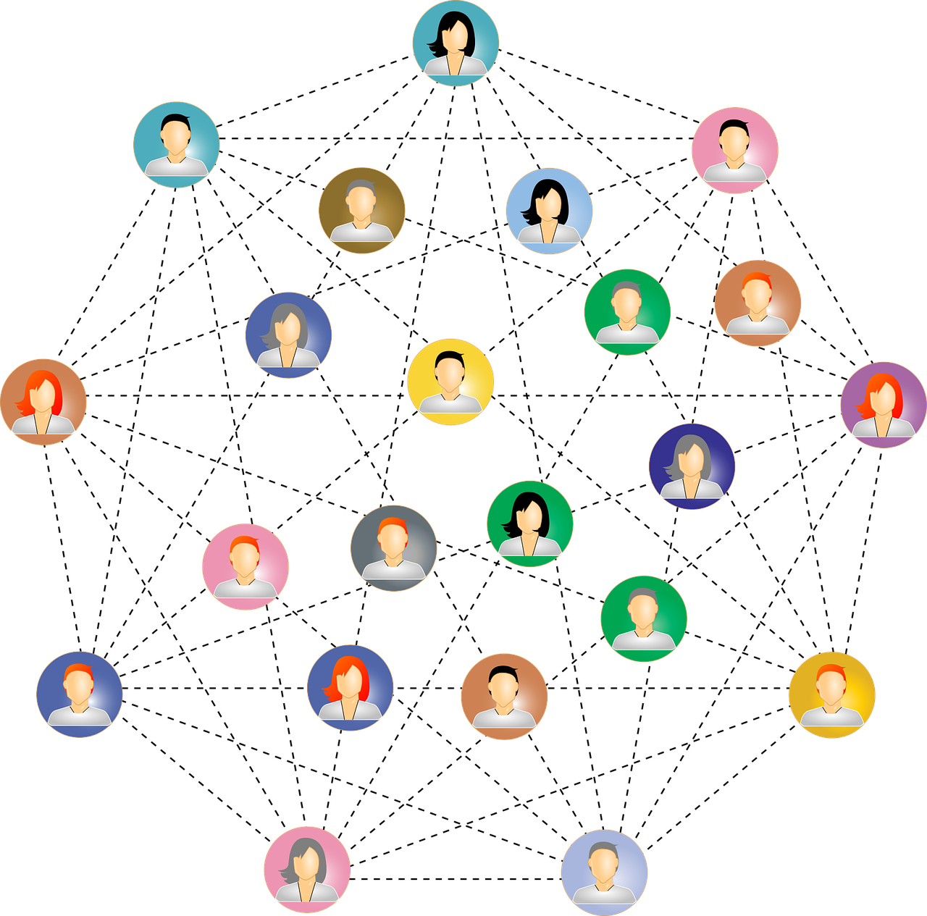
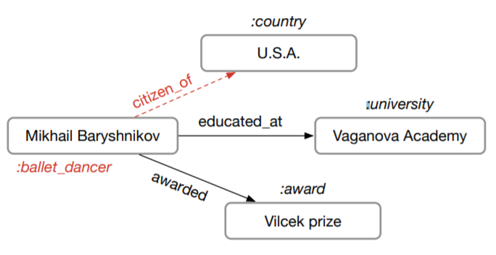
Train GNN on giant graphs
users
products
Social network
Knowledge graph
Recommendation
|V|: 100M – 10B
|V|: 1M – 100M
|V|: 1M – 1000M

Slide 4
Recap: SGD in deep learning

Slide 5
Recap: SGD in deep learning
DL models
Batch 1
The full dataset

Slide 6
How is SGD in GNN models different?
Nodes in graphs have connections.
2
3
1
3
GNN models
10
5
1
4
5
9
4
6
8
8
7
7
11
A batch
The full graph

Slide 7
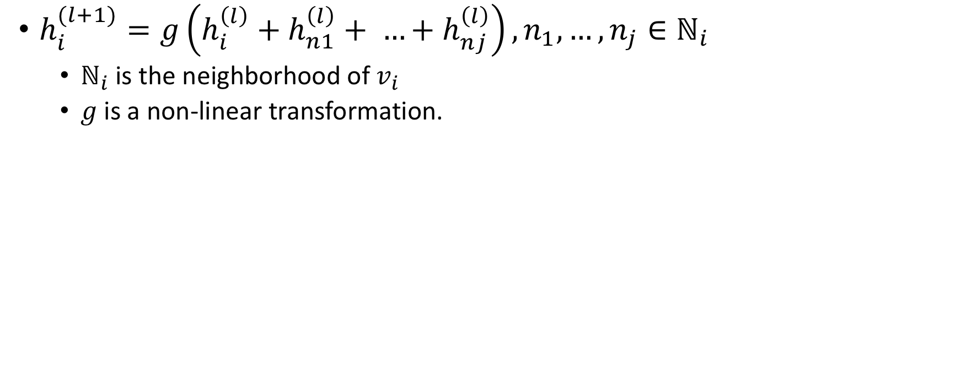
Recap: Graph convolution network
$h_{i}^{(l+1)}=g\left(h_{i}^{\left(l\right)}+h_{n1}^{\left(l\right)}+ …+h_{nj}^{\left(l\right)}\right), n_{1},…,n_{j}∈ℕ_{i}$
$ℕ_{i}$ is the neighborhood of $v_{i}$
$g$ is a non-linear transformation.

Slide 8
Two-layer GNN from the perspective of a vertex
Compute the embedding of node 1 of layer 2
2
3
1
10
5
9
4
6
8
7
11

Slide 9
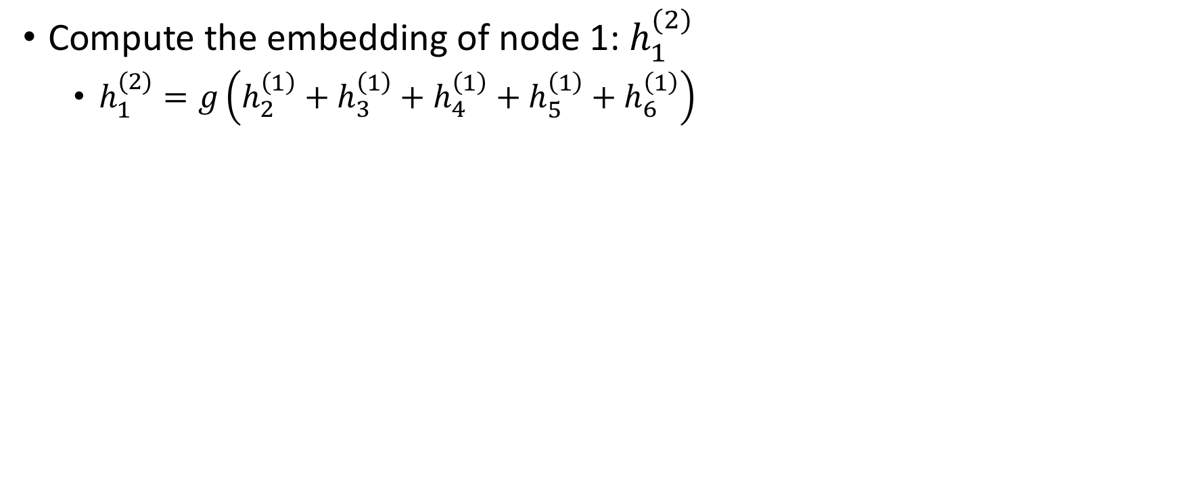
Two-layer GNN from the perspective of a vertex
Compute the embedding of node 1: $h_{1}^{(2)}$
$h_{1}^{(2)}=g\left(h_{2}^{\left(1\right)}+h_{3}^{\left(1\right)}+h_{4}^{\left(1\right)}+h_{5}^{\left(1\right)}+h_{6}^{\left(1\right)}\right)$
2
3
1
10
5
9
4
6
8
7
11

Slide 10
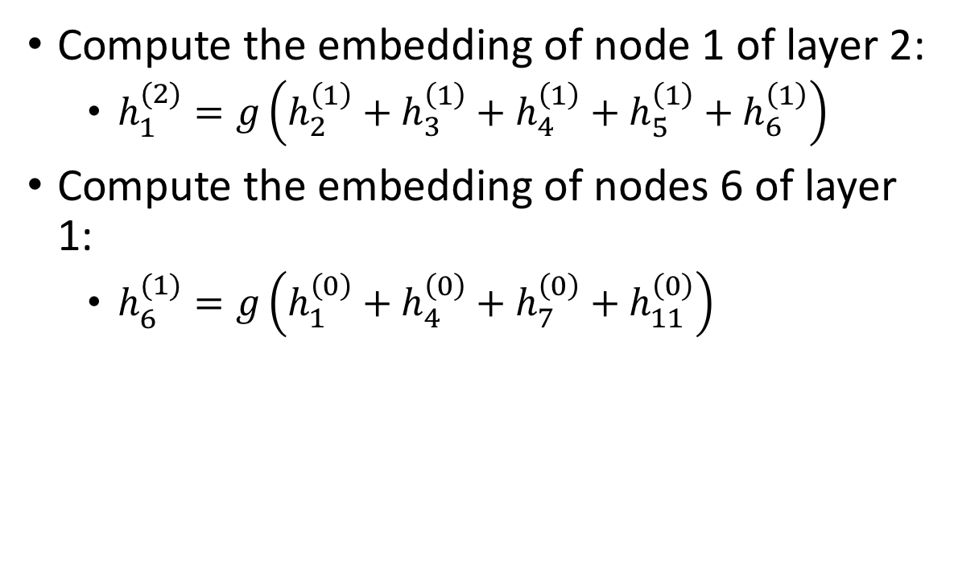
Two-layer GNN from the perspective of a vertex
Compute the embedding of node 1 of layer 2:
$h_{1}^{(2)}=g\left(h_{2}^{\left(1\right)}+h_{3}^{\left(1\right)}+h_{4}^{\left(1\right)}+h_{5}^{\left(1\right)}+h_{6}^{\left(1\right)}\right)$
Compute the embedding of nodes 6 of layer 1:
$h_{6}^{(1)}=g\left(h_{1}^{\left(0\right)}+h_{4}^{\left(0\right)}+h_{7}^{\left(0\right)}+h_{11}^{\left(0\right)}\right)$
2
3
1
10
5
9
4
6
8
7
11

Slide 11
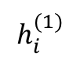
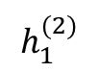
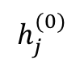
A view of data dependency
Neighborhood size increases exponentially when L increases.
$$h_{1}^{(2)}$$
1
$$h_{i}^{(1)}$$
2
3
4
5
6
$$h_{j}^{(0)}$$
1
3
4
6
7
8
9
10
11

Slide 12
General sampling procedure in graphs
Step 1: randomly sample nodes
Sample nodes for computing node embeddings.
This is equivalent to sample data to create a mini-batch in SGD.
Step 2: randomly prune neighbors
To prune the computation for node embeddings.

Slide 13
Step 1: random sample nodes
1
7
2
8
1
3
9
4
8
10
5
11
6

Slide 14
Step 2: random prune neighbors
1
7
2
8
1
3
9
4
8
10
5
11
6

Slide 15
Neighbor sampling strategies
Neighbor sampling
Layer-wise sampling
Control-variate based sampling

Slide 16
Neighbor sampling
Always sample neighbors from a neighbor list of a vertex.
1
1
2
3
4
5
6
2
4
1
7
8
1
3
4
6
7
8
9
10
11
Node embedding estimation is bias ➔ gradient estimation is biased.

Slide 17
Layer-wise sampling
Sampling neighbors in layers and construct induced subgraphs between layers.
1
1
2
3
4
5
6
6
4
11
7
8
1
3
4
6
7
8
9
10
11

Slide 18
Control variate based sampling
Use history data to estimate node embedding with fewer sampled neighbors.
1
1
2
3
4
5
6
2
5
6
4
3
1
7
8
10
1
3
4
6
7
8
9
10
11

Slide 19
NodeFlow
The DGL API defined for training GNN models with the sampling methods.

Slide 20
Why design NodeFlow?

Slide 21
NodeFlow
The DGL API defined for training GNN models with the sampling methods.
Nodes are grouped into layers.
To access node data:
nf.layers[0].data[‘h’]
To perform computation on nodes:
nf.apply_layers(0)
1
Layer 2: output layer
2
4
Layer 1
1
7
8
Layer 0: input layer

Slide 22
NodeFlow
The DGL API defined for training GNN models with the sampling methods.
Nodes are grouped into layers.
Edges are grouped into blocks.
To access edge data:
nf.blocks[0].data[‘h’]
To perform computation on edges:
nf.block_compute(0)
1
Block 1
2
4
Block 0
1
7
8

Slide 23
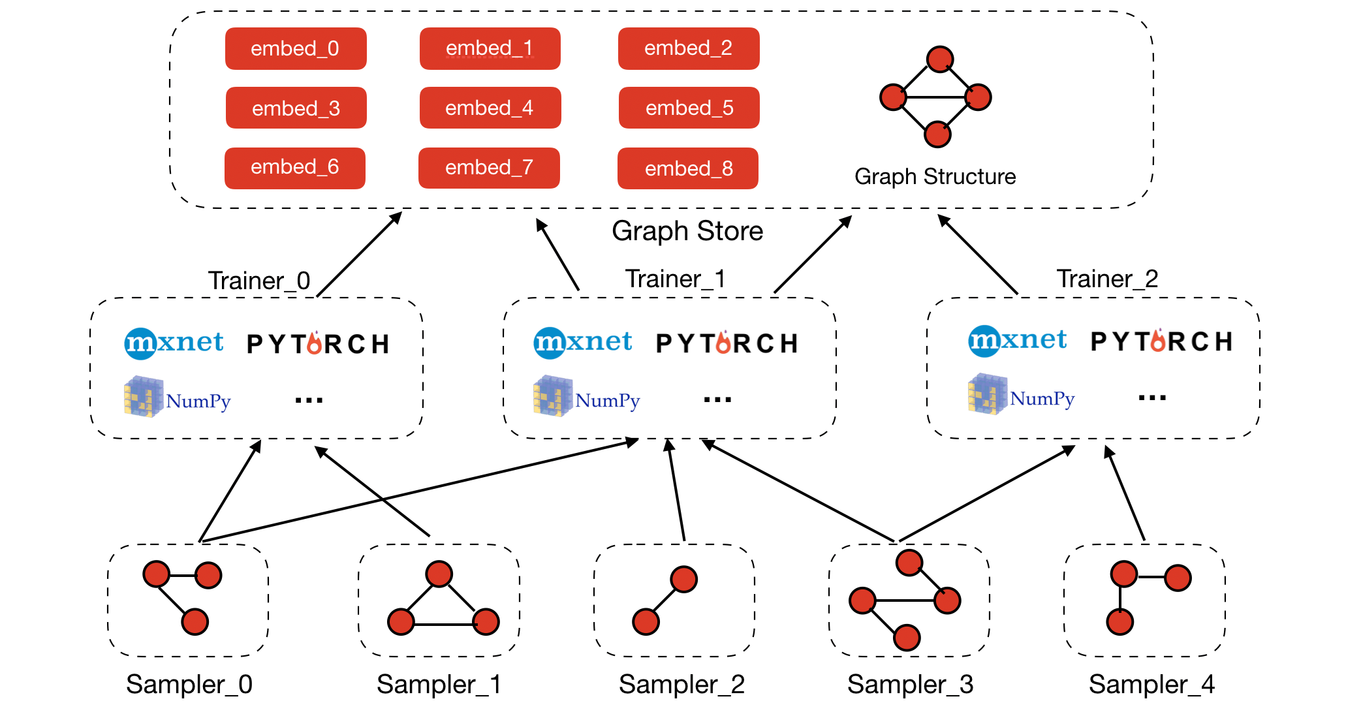
DGL architecture for scaling

Slide 24
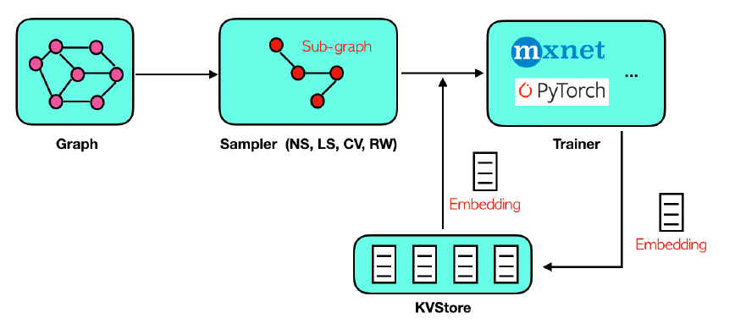
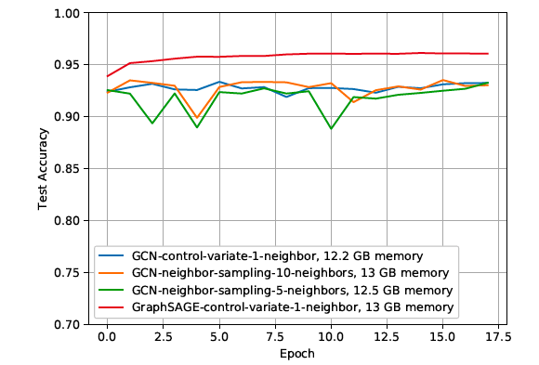
Is DGL scalable?
Support different sampling algorithms
Neighbor sampling
Layer-wise sampling
Control-variate sampling
Random walk sampling

Slide 25
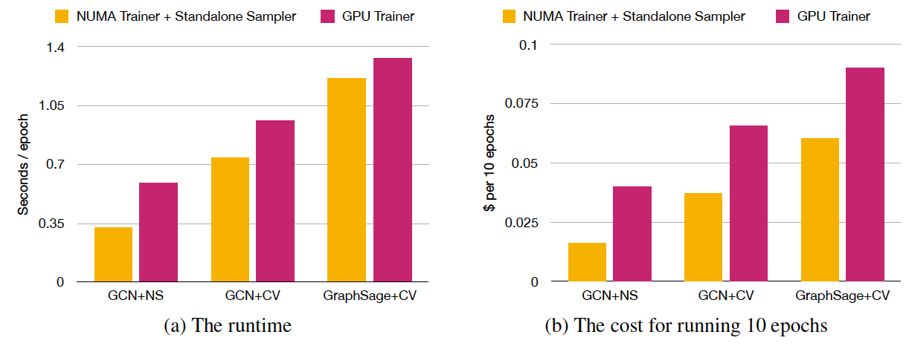
Is DGL scalable?
Supported hardware for scaling: multiple GPUs and multi-processor machines.
Multi-processor machines are more efficient and cost-effective for simple graph neural networks.

Slide 26
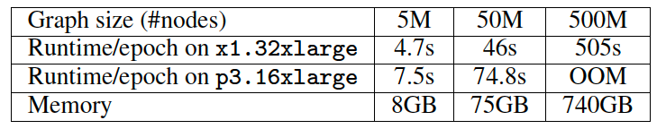
Is DGL scalable?
Scaling to graphs with 500M nodes on a machine with 2TB RAM.
The full distributed solution is under development.

